Slide 1

Diamond Store
Weekend Promotion

Slide 2
Objective
Diamond Merchant is looking to open a shop retailing diamonds to the general public. The need is an inventory of the diamonds the merchant has select for sale in the shop.
Opening weekend promotion in which some diamonds are discounted to entice more custom
Identify 150 diamonds to promote;
Offer 10% off the selected diamonds;
Maximum $45.000 total discount;
The diamonds must be enticing to customers and must not purely be poor quality, small diamonds only;
As much as is reasonably possible, they doesn’t want to discount any very high-quality diamonds.

Slide 3
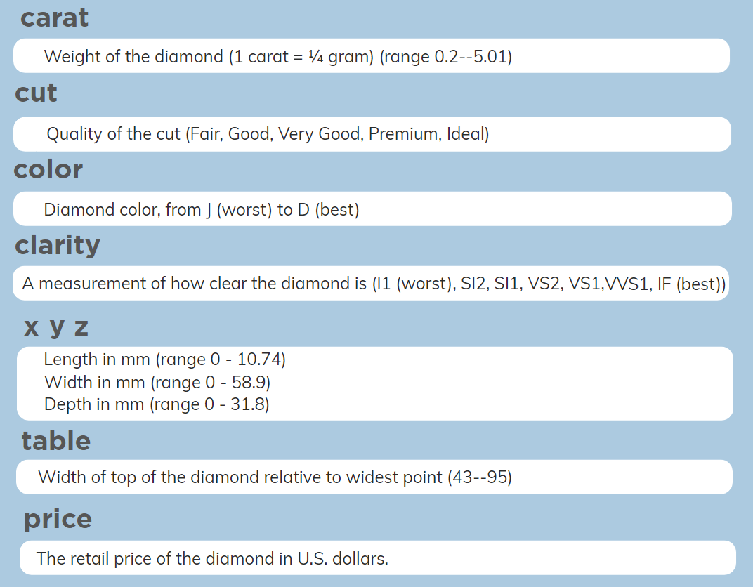


Slide 4
Modelling the database
Fist of all, I created columns (Item ID, Promotion, Volume, Price/Carat and Promotion)
Cleansing and drop items that probably are wrong in the data set;
Correlation of price between the features;
Regression analyses of price;
Drop items that the owner don’t want to offer;
Split de diamonds by features and categorize the structure of the promotion.
Show how and which formulas I've been used to find the best items to flag.

Slide 5
Summary of diamonds selected
Drop worst colour, cut and Clarity: 1.045 items
Best CUT (Ideal and Premium): 35.328 items (Chosen 15 items selected to entice high exigent customers)
Cut “Fair” with medium colour and clarity: 418 items (Chosen 30 items to entice customers with low price)
Small Diamonds (0.2 to 0.9 carat): 12.424 items (Chosen 90 items which represents the sample II of the dataset)
From the sample, Carat (0.2 to 0.5 carat): 5.266 items (30 items selected that represents the media of the data)
From the sample, Carat (0.5 to 0.7 carat): 3,034 items (30 items selected that represents the media of the data)
Carat (0.7 to 0.9 carat): 3.346 items (30 items selected that represents the media of the data)
Great discounts - Carat (0.9 to 1.5 carat): 3.346 items (15 items selected that represents big sizes of diamonds)
Quantity Total of Items 53920
Quantity of duplicates 293
Correlation Price/Carat 0.92%
Correlation Price/Volume 0.90%
Correlation Price/Depth 0.01%
Correlation Price/table 0.12%
Null Values 20

Slide 6
Summary of diamonds selected
Sample 01 – Diamonds carat 0.2 to 0.9
Best Cut (Ideal and Premium): 15 Items – Total Discount: $4809.00
Cut “Fair” with medium colour and clarity: 30 items – Total Discount: $6,682.20
Sample 02 – Diamonds carat 0.2 to 0.9 with media quality
Carat (0.2 to 0.5 carat): 30 items – Total Discount: $3,152.80
Carat (0.5 to 0.7 carat): 30 items – Total Discount: $5,573.80
Carat (0.7 to 0.9 carat): 30 items – Total Discount: $9,923.60
Sample 03 – Diamonds carat 1 to 1.5
Great discounts – Cut (Good, Very Good and Ideal): 15 Items – Total Discount $14.929.50

Slide 7
Criteria for selection
Sample 01 was created to entice customers whit the best of the cut, colour and clarity.
Sample 02 was created considering the table size relating to carat.
Sample 03 was created to entice customers who likes big diamonds.
Sample 1 | Sample 2 | Sample 3
45 Items | 90 Items | 15 Items
Discount $11,602.60 | Discount $18,650.20 | Discount $14.929.50
Total Discount $44,838.50 | 84 | 90

Slide 8
Structure of Promotion
Best Quality
Low Price
25 Items
- Carat between 0.2 to 0.9
- CUT (Ideal and Premium)
25 Items - Carat between 0.2 to 0.9
- CUT (Fair) - Good Colour and Clarity
100 Items
- Carat between 0,2 to 1,5
- CUT (Very Good and Good) - Good Colour and Clarity
Availability

Slide 9
Chart of items

Slide 10
Chart of items

Slide 11
Sample 01 – Best Cut (Ideal and Premium):
Item ID | Carat | Cut | Color | Clarity | Depth | Table | Price | X | Y | Z | Volume | Price/Carat | Discount | Why to choose this Item? | Total Discount
High Category - Smallest Size (0.25 to 0.44 Carat)
47842 | 0.4 | Ideal | F | VVS1 | 61.1 | 56 | $1,908.00 | 4.78 | 4.81 | 2.93 | 67.4 | $ 4,770.00 | $ 190.80 | Small and expensive | $ 190.80
43349 | 0.37 | Ideal | F | VVS1 | 59.2 | 57 | $1,406.00 | 4.75 | 4.71 | 2.8 | 62.6 | $ 3,800.00 | $ 140.60 | high Quality Cut And Collor | $ 331.40
43040 | 0.33 | Ideal | E | VVS1 | 61.9 | 57 | $1,374.00 | 4.46 | 4.43 | 2.75 | 54.3 | $ 4,163.64 | $ 137.40 | All Rouder and High Price | $ 468.80
40256 | 0.3 | Ideal | E | VVS2 | 61.4 | 55 | $1,125.00 | 4.36 | 4.34 | 2.67 | 50.5 | $ 3,750.00 | $ 112.50 | Big Discount | $ 581.30
41020 | 0.25 | Premium | G | SI2 | 59 | 60 | $1,186.00 | 5.33 | 5.28 | 3.12 | 87.8 | $ 4,744.00 | $ 118.60 | Big but Cheap | $ 699.90
High Category - Medium Size (0.45 to 0.65 Carat)
43573 | 0.41 | Premium | E | VVS1 | 60.7 | 58 | 1431 | 4.86 | 4.8 | 2.93 | 68.351 | 3490.2439 | 143.1 | Small and expensive | $ 843.00
50043 | 0.49 | Ideal | E | VVS2 | 61.9 | 56 | $2,199.00 | 5.05 | 5.1 | 3.14 | 80.9 | $ 4,487.76 | $ 219.90 | Cheapest per Carat | $ 1,062.90
3276 | 0.51 | Premium | F | SI1 | 62.7 | 62 | $3,360.00 | 5.09 | 4.96 | 3.15 | 79.5 | $ 6,588.24 | $ 336.00 | All Rouder and High Price | $ 1,398.90
3584 | 0.59 | Ideal | E | VVS1 | 60.7 | 57 | $3,422.00 | 5.41 | 5.45 | 3.29 | 97.0 | $ 5,800.00 | $ 342.20 | Highest Quality | $ 1,741.10
2492 | 0.6 | Ideal | F | VVS2 | 61.5 | 57 | $3,196.00 | 5.42 | 5.45 | 3.34 | 98.7 | $ 5,326.67 | $ 319.60 | Cheapest per Carat | $ 2,060.70
High Category - High Size (0.66 to 0.875 Carat)
5226 | 0.69 | Ideal | F | VVS1 | 61.6 | 56 | 3784 | 5.69 | 5.71 | 3.51 | 114.0 | $ 5,484.06 | $ 378.40 | Small and expensive | $ 2,439.10
14181 | 0.81 | Ideal | E | VVS1 | 62.5 | 54 | 5752 | 5.95 | 5.98 | 3.73 | 132.72 | $ 7,101.23 | $ 575.20 | Cheapest per Carat | $ 3,014.30
12603 | 0.75 | Premium | F | VVS1 | 60.6 | 57 | 5288 | 5.88 | 5.94 | 3.59 | 125.4 | $ 7,050.67 | $ 528.80 | All Rouder and High Price | $ 3,543.10
12897 | 0.81 | Ideal | E | VVS2 | 62.2 | 53.7 | 5373 | 5.97 | 5.99 | 3.72 | 133.03 | $ 6,633.33 | $ 537.30 | Best CUT | $ 4,080.40
18012 | 0.9 | Ideal | E | VVS2 | 62.8 | 54 | 7286 | 6.11 | 6.21 | 3.87 | 146.8 | $ 8,095.56 | $ 728.60 | Big Discount | $ 4,809.00

Slide 12
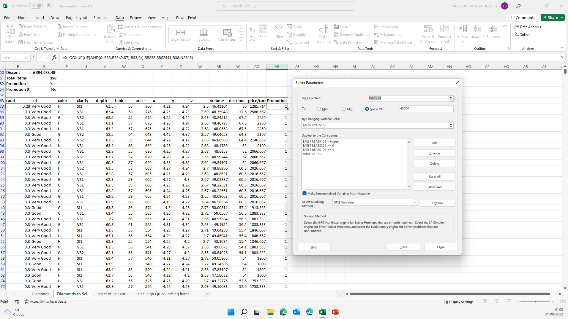
Formulas and Tools
I tend to do everything in excel, the main formulas used are Xlookup, Filter and IFS.
In order to achieve the best results in terms of the restrictions, I used the solver tool, creating hypothetical poles to achieve the best results.

Slide 13
Talysson Oliveira
Data Analyst

